Slide 1
Chocolate sales analysis
By
Battula Naveen kumar

Slide 2
CAPSTONE POWER BI PROJECT:CHOCOLATE SALES
AIM:
In this project, I'm going to preprocess and clean data, run exploratory data analysis (EDA) and find descriptive statistical measurements as analysis data with making an interactive dashboard for a dataset which contains nearly 300 plus data.
LANGUAGE, LIBRARIES, TOOLS:
Language: Python
Libraries: Pandas, NumPy
Ide: Jupyter NotebookApplication: Microsoft Excel, Microsoft PowerBI

Slide 3
DATA COLUMNS
Sales Person :Individual responsible for selling products or services to customers.
Geography :The specific location or region where sales activities occur.
Product :A tangible or intangible item offered for sale.
Amount :The total monetary value of sales transactions.
Units :The quantity of products sold.
cost per unit :The expense incurred for producing or purchasing each unit.
Cost :The total expenditure associated with producing or acquiring the units sold.
Profit :The difference between total revenue (amount) and total cost.
profit % :The percentage representing the profitability of sales, calculated as (Profit / Amount) * 100.

Slide 4
OBJECTIVE
The primary goal is often to develop predictive models that can accurately anticipate chocolate sales, involving the analysis of historical data to identify patterns and trends that can be utilized to predict future chocolate purchasing behavior.
A secondary goal is to categorize chocolate sales into specific groups based on their characteristics and purchasing behaviors. This segmentation approach allows for the customization of marketing strategies tailored to specific chocolate sales segments, thereby enhancing their effectiveness. Data science techniques such as clustering can be applied for this segmentation process.

Slide 5
METHODOLOGY
Collect and integrate data from Kaggle's "Chocolate Sales Analysis" dataset, merging key components such as boxes, products, and sales to establish a comprehensive foundation for insights and analysis in the domain of chocolate sales.
Crafting an engaging and user-friendly Power BI dashboard specifically tailored for chocolate sales. This involves integrating features that facilitate interactive exploration of sales data, enabling a dynamic and insightful analysis of user preferences and purchasing patterns in the chocolate market.

Slide 6
TOOLS & TECHNOLOGIES
POWER BI FOR DASHBOARD
EXCEL FOR DATA EXTRACTION

Slide 7
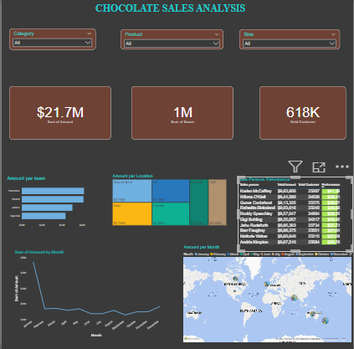
DASHBOARD

Slide 8
CONCLUSION
In conclusion, the Power BI dashboard for chocolate sales not only captivates with its visual appeal but also empowers us to delve into user preferences seamlessly. With its interactive features, it's a game-changer for understanding chocolate sales dynamics, enabling us to make informed and strategic decisions in this sweet world of marketing.

